Slide 1

Azure Firewall

Slide 2

AGENDA
Task 1: Set up a test network environment
Task 2: Deploy a firewall
Task 3: Create a default route
Task 4: Configure an application rule to allow access to www.google.com
Task 5: Configure a network rule to allow access to external DNS servers
Task 6: Configure a NAT rule to allow a remote desktop to the test server
Task 7: Test the firewall
Task 8: Delete the resources you created for this exercise. You can delete resources individually or the entire resource group containing the resources. Take care when deleting resource groups, as all resources in the resource group will also be deleted.

Slide 3

Task 1: Set up a test network environment

Slide 4

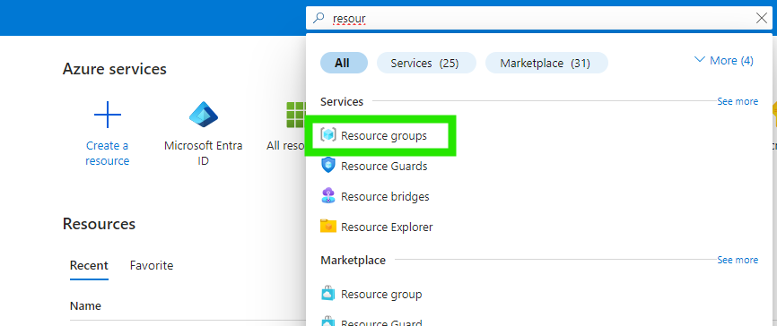
1. Sign in to the Azure portal with your login credentials.
2. On the Azure portal menu, select Resource Groups or select Resource Groups.

Slide 5
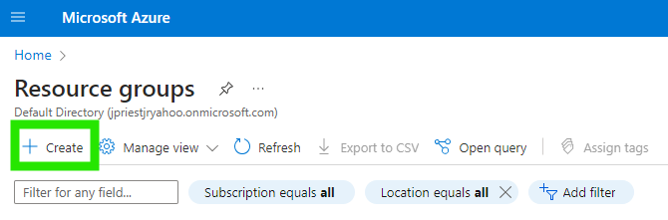
3. Then, select Create.

Slide 6
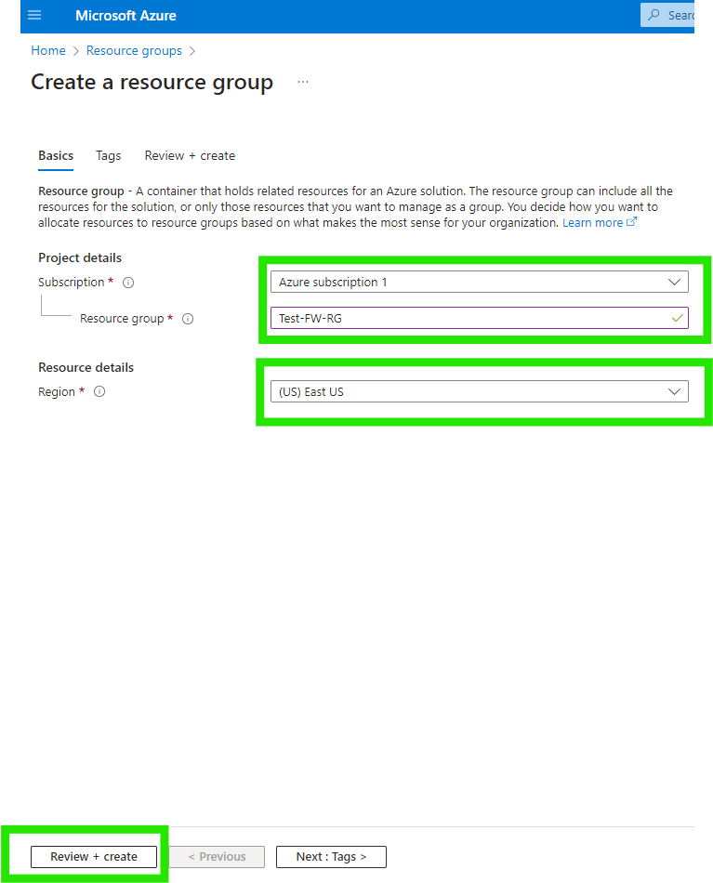
4. For Subscription, select your subscription.
5. For Resource group name, type Test-FW-RG.
6. For Region, select a region. All other resources that you create must be in the same region.
Select Review + create.
Select Create.

Slide 7
Task 2: Deploy a firewall Create a Virtual Network: This VNet will have two subnets.

Slide 8

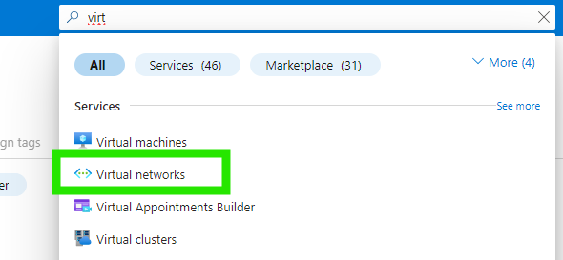
1. On the Azure portal menu or from the Home page, search for and select Virtual networks.

Slide 9

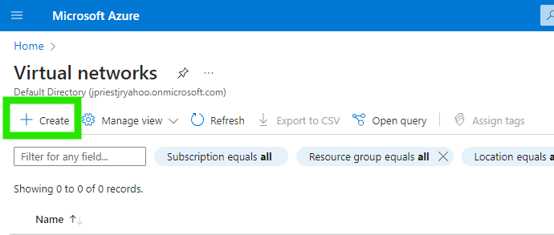
2. Select Create.

Slide 10
1. On the Azure portal menu or from the Home page, search for and select Virtual networks.

Slide 11
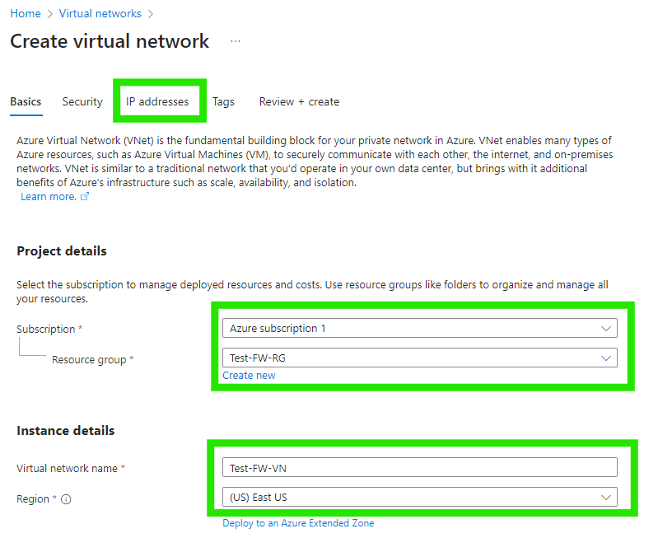
For Subscription, select your subscription.
For Resource group, select Test-FW-RG.
For Name, type Test-FW-VN.
For Region, select a region.
Note: All other resources that you create must be in the same region.
Select Next: IP addresses.

Slide 12
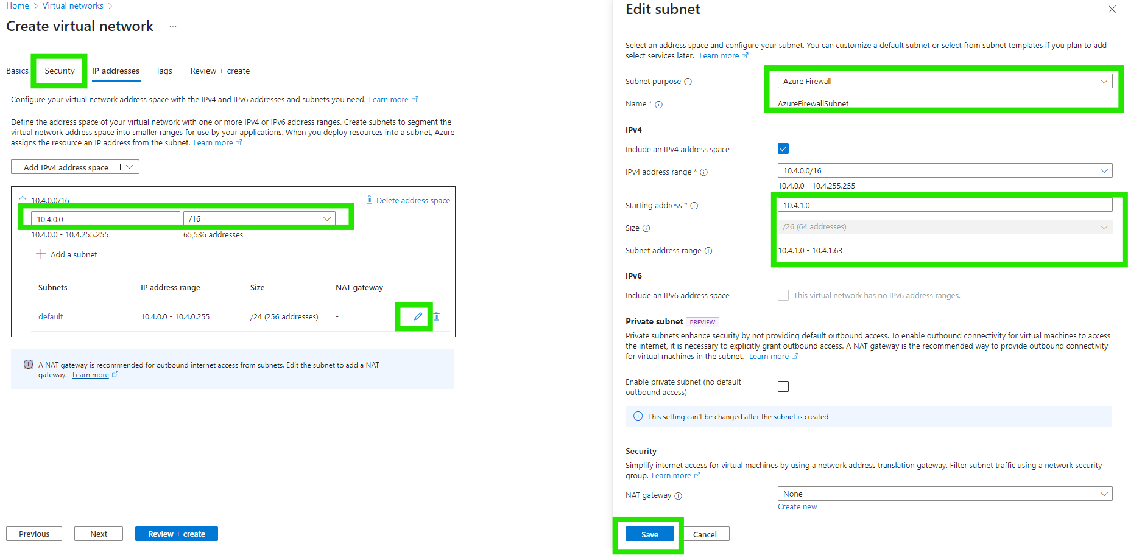
For Address space, accept the default 10.4.0.0/16 or choose according to your convenience.
Under Subnet name, select default and change it to AzureFirewallSubnet. The firewall will be in this subnet, and the subnet name must be AzureFirewallSubnet.
For Subnet address range, change it to 10.4.1.0/26.
Select Save.

Slide 13
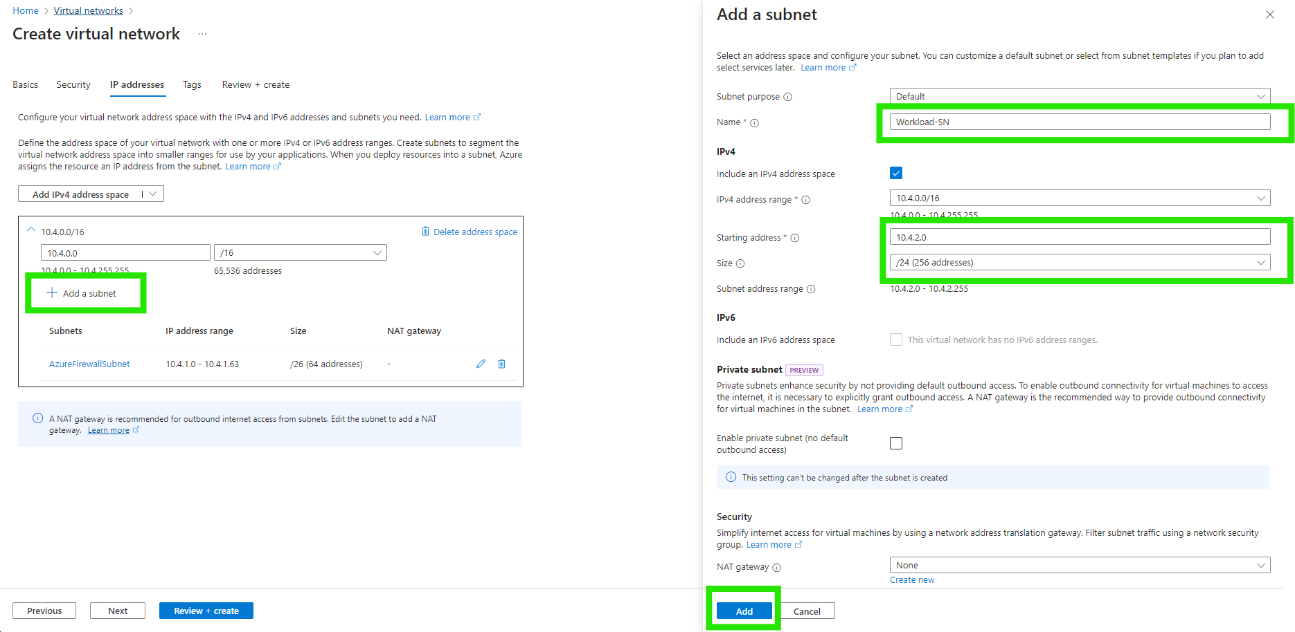
Select Add subnet.
For Subnet name, type Workload-SN.
For Subnet address range, type 10.4.2.0/24.
Select Add.

Slide 14
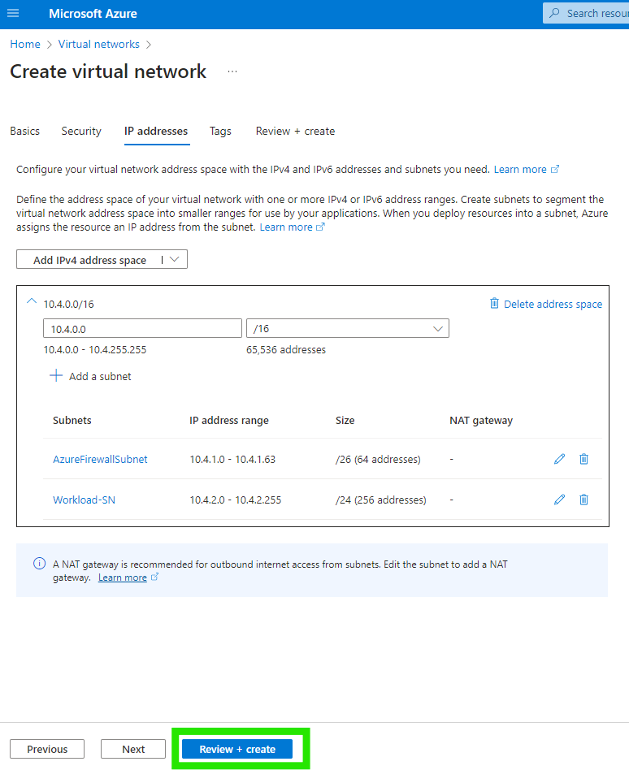
Select Review + create.
Select Create.

Slide 15
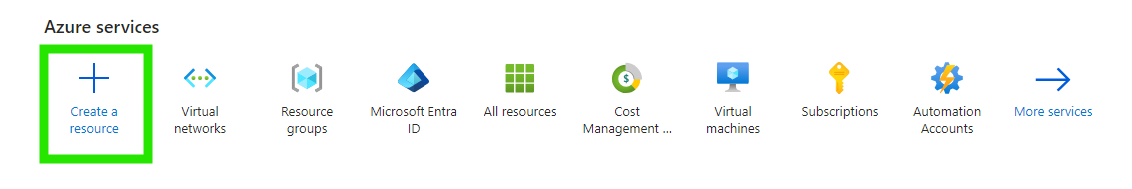
Create a virtual machine: Now create the workload virtual machine and place it in the Workload-SN subnet.
On the Azure portal menu or from the Home page, select Create a resource.

Slide 16
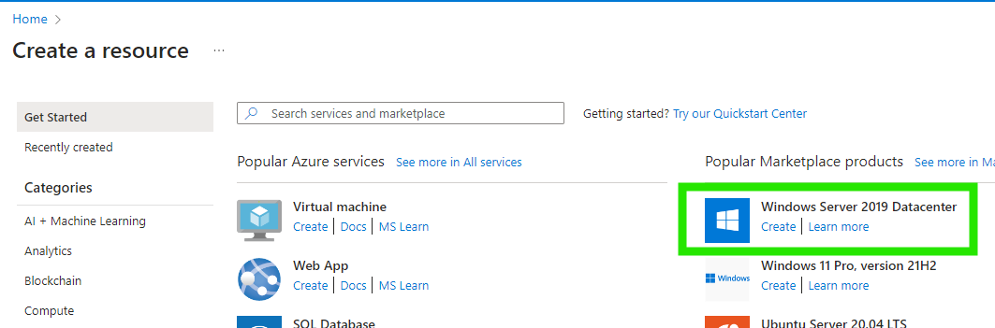
Select Windows Server 2019 Datacenter.

Slide 17
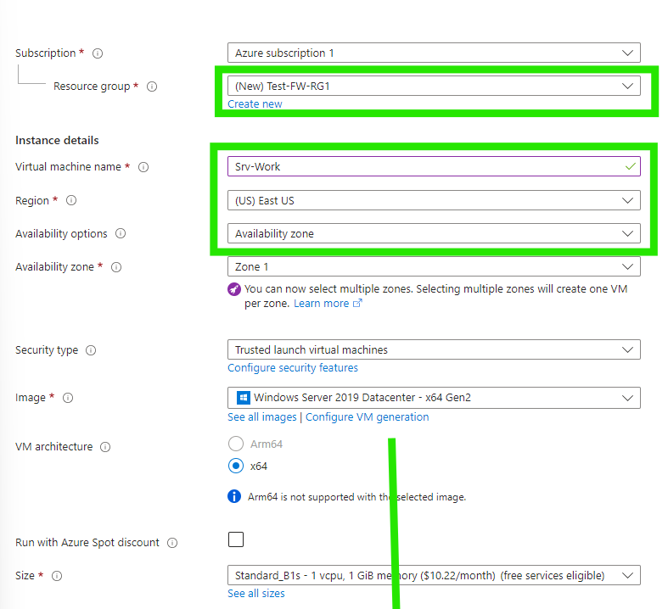
Enter these values for the virtual machine:
Resource group: Test-FW-RG
Virtual machine name: Srv-Work
Region: Same as previous
Image: Windows Server 2019 Datacenter
Administrator username: Type a username
Password: Type a password
Under Inbound port rules, Public inbound ports, select None.
Accept the other defaults and select Next: Disks.

Slide 18
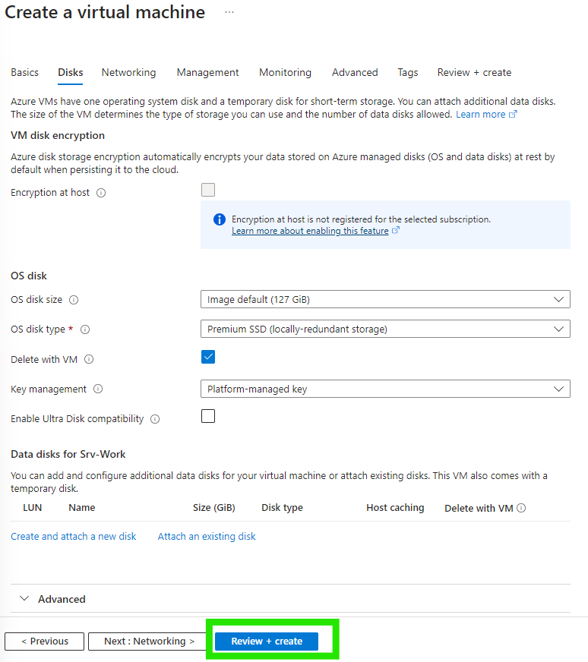
Accept the disk defaults and select Next: Networking.

Slide 19
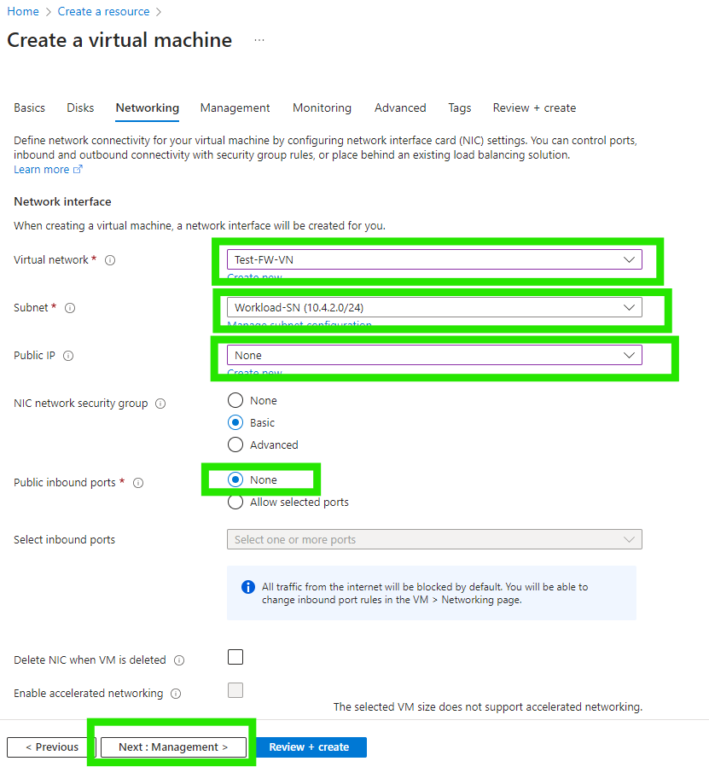
Make sure that Test-FW-VN is selected for the virtual network and the subnet is Workload-SN.
For Public IP, select None.
Accept the other defaults and select Next: Management.

Slide 20
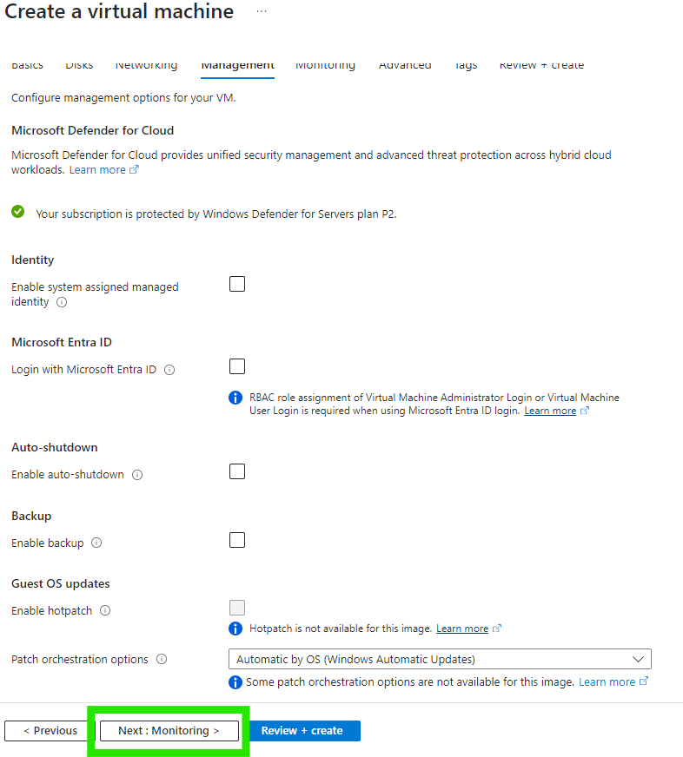
Accept the defaults and select Next: Monitoring.

Slide 21
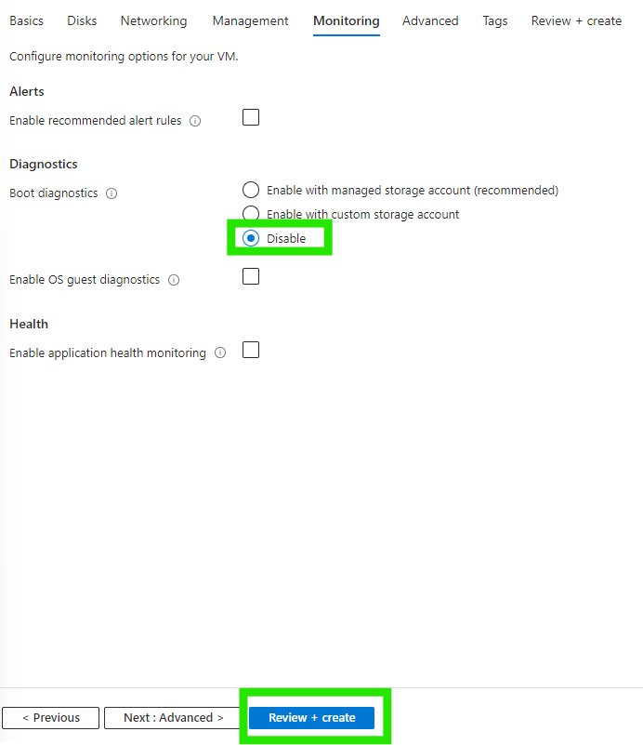
For Boot diagnostics, select Disable to disable boot diagnostics. Accept the other defaults and select Review + create.
Review the settings on the summary page, and then select Create.

Slide 22
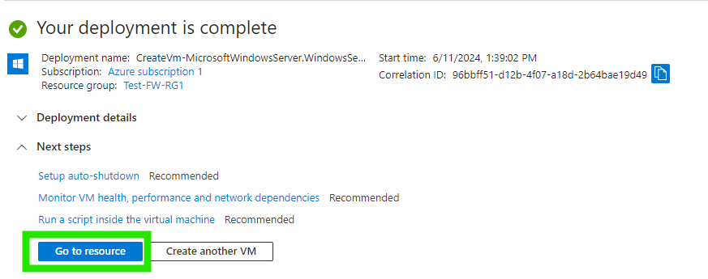
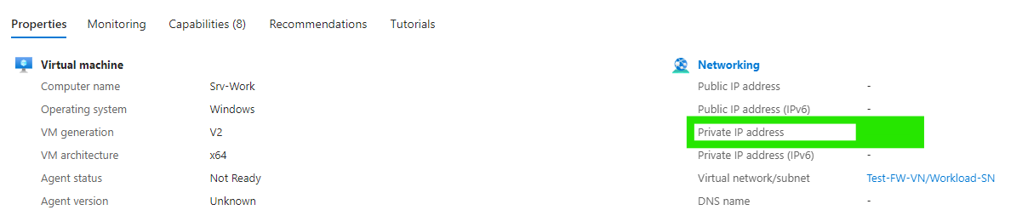
After the deployment is complete, select Go to resource and note the Srv-Work private IP address that you'll need to use later.

Slide 23
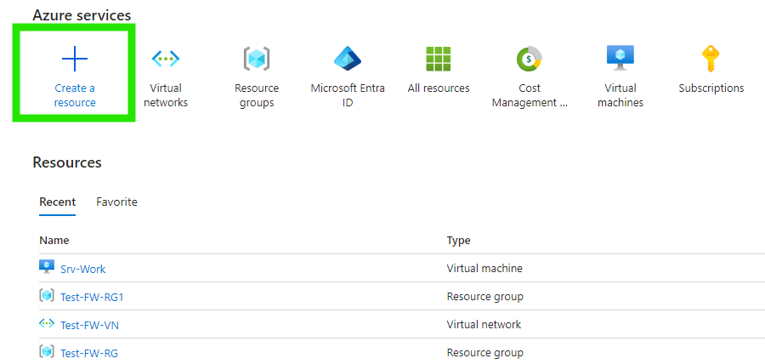
Deploy the firewall: Deploy the firewall into the virtual network
On the Azure portal menu or from the Home page, select Create a resource.

Slide 24
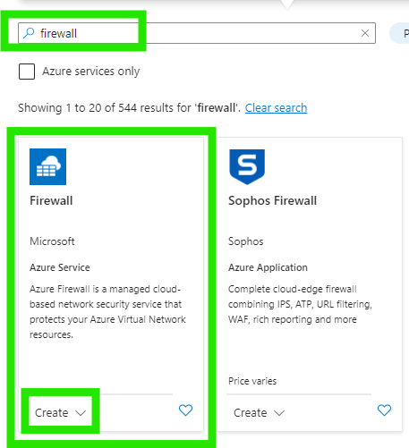
Type firewall in the search box and press Enter and select Firewall.

Slide 25
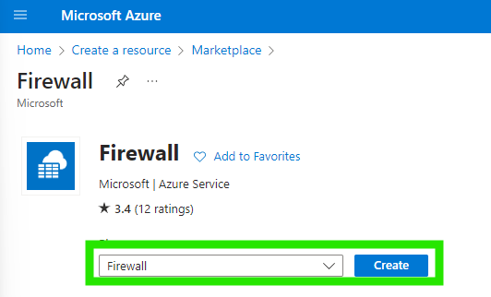
Select Create.

Slide 26
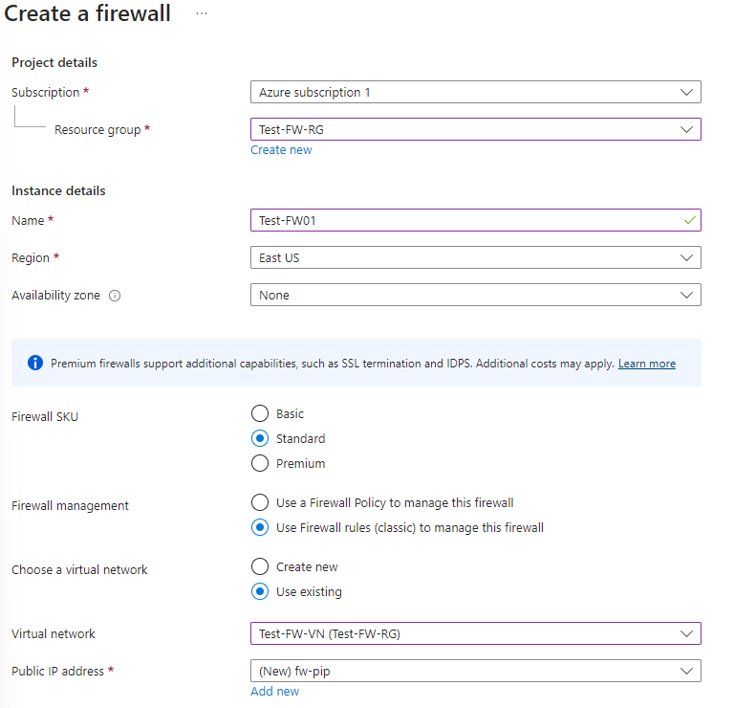
On the Create a Firewall page, use the following table to configure the firewall:
Subscription: <your subscription>
Resource group: Test-FW-RG
Name: Test-FW01
Region: Select the same location that you used previously.
Firewall SKU: Standard
Firewall management: Use Firewall rules(classic) to manage this firewall.
Choose a virtual network: Use existing: Test-FW-VN
Public IP address: Add new; Name: fw-pip
Accept the other default values, then select Review + create.
Review the summary, and then select Create to create the firewall.

Slide 27
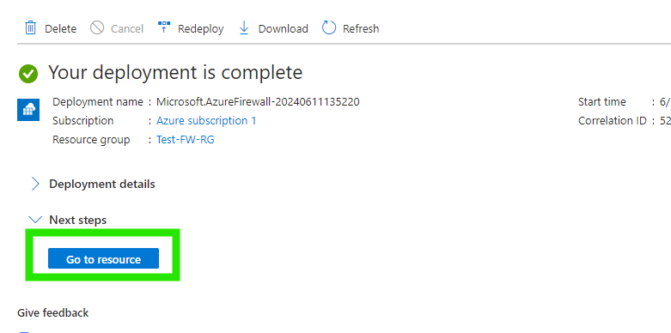
This will take a few minutes to deploy.
After deployment completes, select the Go to resource.
Note: the firewall private and public IP addresses. You'll use these addresses later.

Slide 28
Task 3: Create a default route

Slide 29
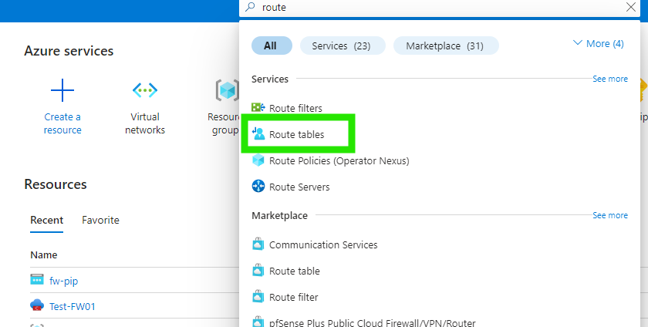
For the Workload-SN subnet, configure the outbound default route to go through the firewall.
On the Azure portal, search for and select Route tables.

Slide 30
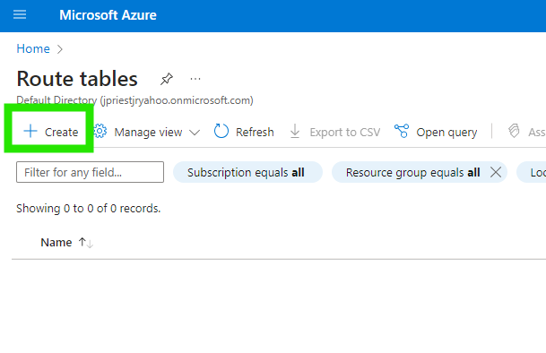
Select Create.

Slide 31
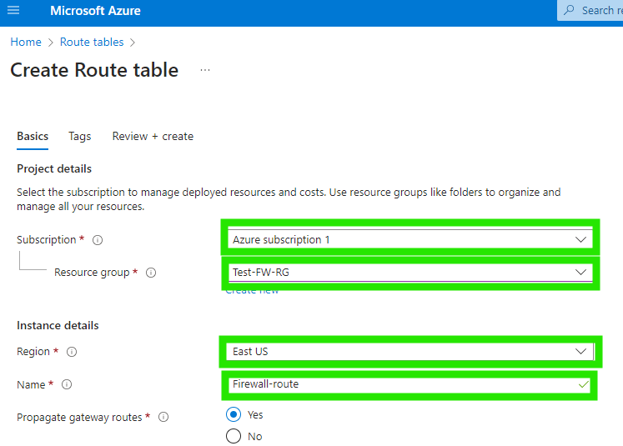
For Subscription, select your subscription.
For Resource group, select Test-FW-RG.
For Region, select the same location that you used previously.
For Name, type Firewall-route.
Select Review + create.
Select Create.

Slide 32
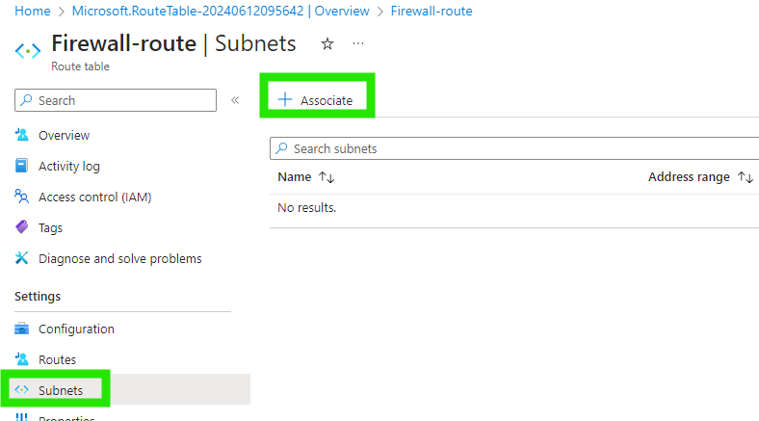
After deployment completes, select Go to resource.
On the Firewall-route page, under Settings blade, select Subnets and then select Associate.

Slide 33
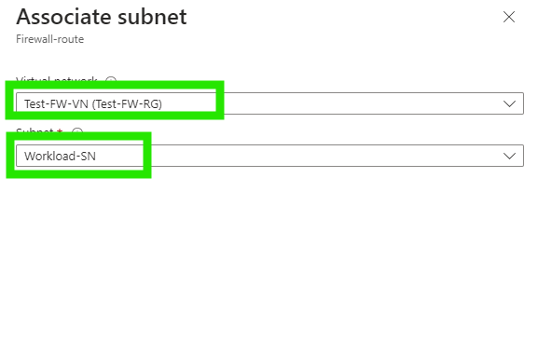
For Virtual network, select Test-FW-VN.
For Subnet, select Workload-SN. Make sure that you select only the Workload-SN subnet for this route, otherwise your firewall won't work correctly.
Select OK.

Slide 34
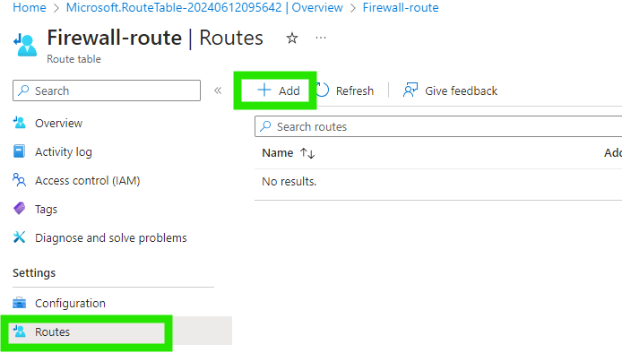
Select Routes and then select Add.

Slide 35
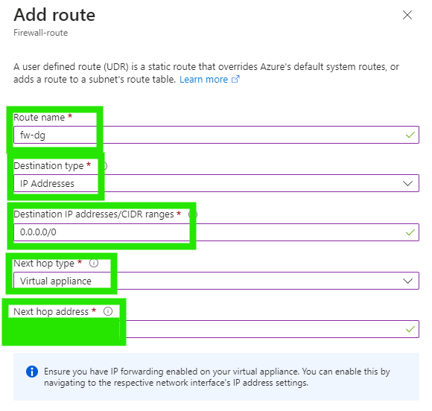
For Route name, type fw-dg.
For Destination address prefix, select IP Addresses.
For Destination IP addresses/CIDR ranges, type 0.0.0.0/0.
For Next hop type, select Virtual appliance.
Azure Firewall is a managed service, but virtual appliance works in this situation.
For Next hop address, type the private IP address for he firewall that you noted previously.
Select Add.

Slide 36
Task 4: Configure an application rule This is the application rule that allows outbound access to www.google.com

Slide 37
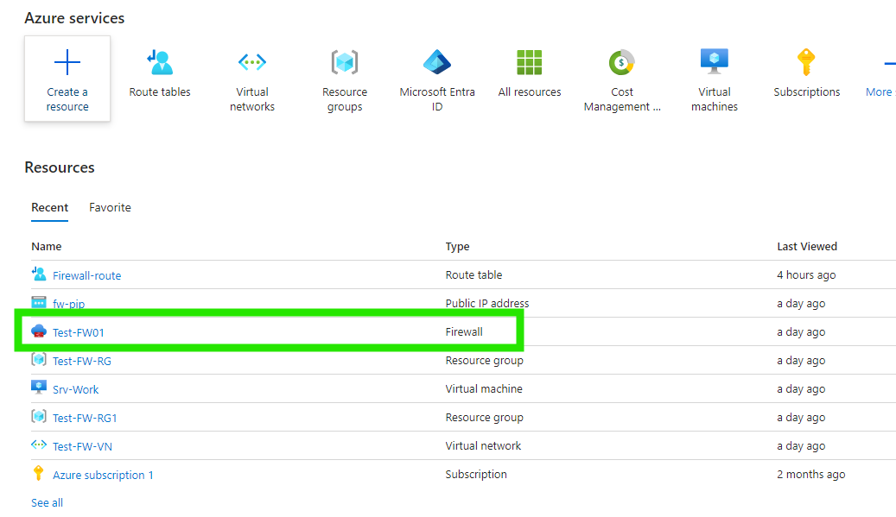
Open the Test-FW-RG and select the Test-FW01 firewall.

Slide 38
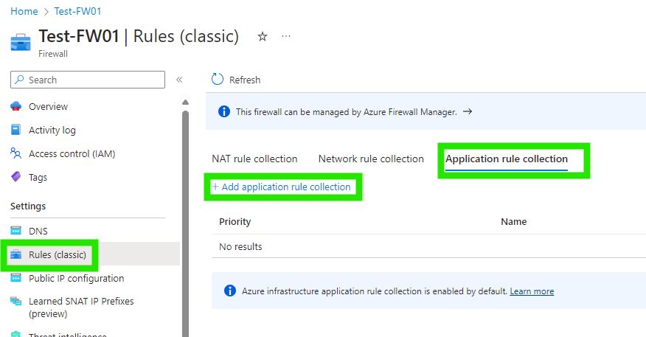
On the Test-FW01 page, under Settings, select Rules (classic).
Select the Application rule collection tab.
Select Add application rule collection.

Slide 39
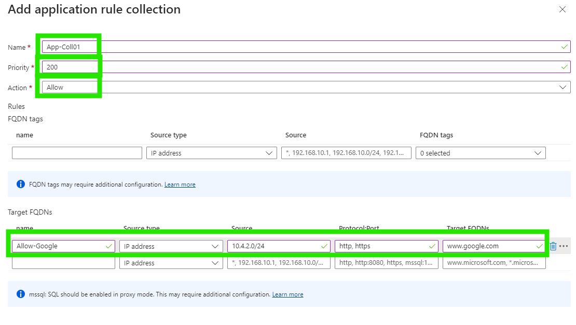
For Name, type App-Coll01.
For Priority, type 200.
For Action, select Allow.
Under Rules, Target FQDNs, for Name, type Allow-Google.
For Source type, select IP address.
For Source, type 10.4.2.0/24.
For Protocol:port, type http, https.
For Target FQDNS, type www.google.com.
Select Add.

Slide 40
Task 5: Configure a network rule to allow access to external DNS servers This is the network rule that allows outbound access to two IP addresses at port 53 (DNS).

Slide 41
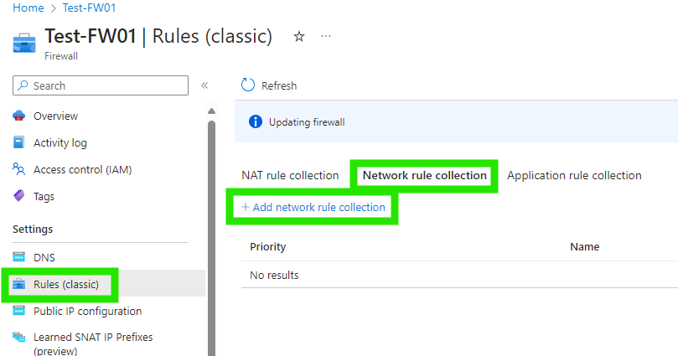
On the Test-FW01 page, under Settings, select Rules (classic).
Select the Network rule collection tab.
Select Add network rule collection.

Slide 42
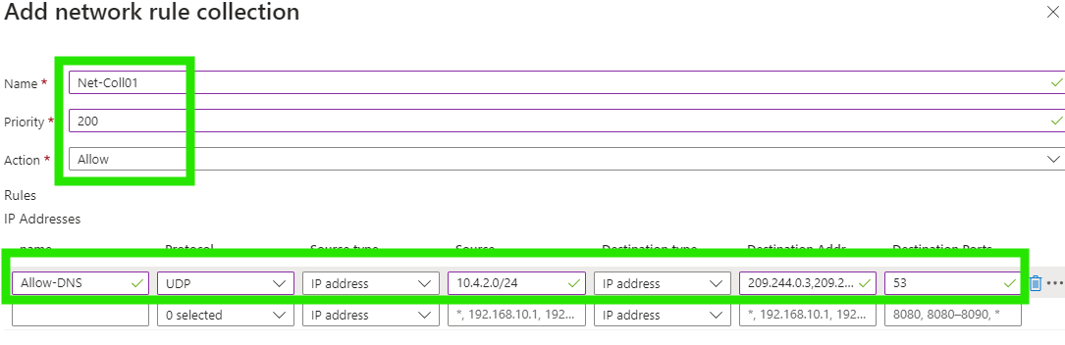
For Name, type Net-Coll01.
For Priority, type 200.
For Action, select Allow.
Under Rules, IP addresses, for Name, type Allow-DNS.
For Protocol, select UDP.
For Source type, select IP address.
For Source, type 10.4.2.0/24.
For Destination type select IP address.
For Destination address, type 209.244.0.3,209.244.0.4
These are public DNS servers operated by Level3.
For Destination Ports, type 53.
Select Add.

Slide 43
Task 6: Configure a NAT rule to allow a remote desktop to the test server

Slide 44
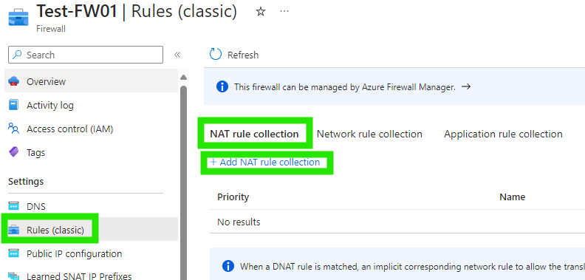
On the Test-FW01 page, under Settings, select Rules (classic).
Select the NAT rule collection tab.
Select Add NAT rule collection.

Slide 45
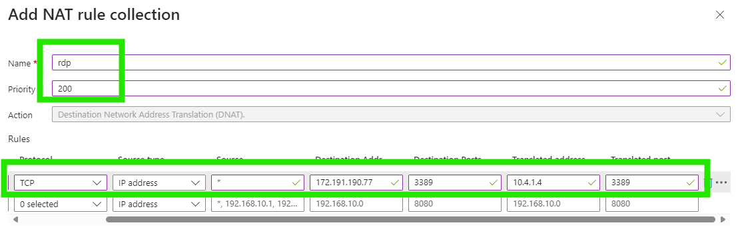
For b, type rdp.
For Priority, type 200.
Under Rules, for Name, type rdp-nat.
For Protocol, select TCP.
For Source type, select IP address.
For Source, type *.
For Destination address, type the firewall public IP address.
For Destination Ports, type 3389.
For Translated address, type the Srv-work private IP address.
For Translated port, type 3389.
Select Add.

Slide 46
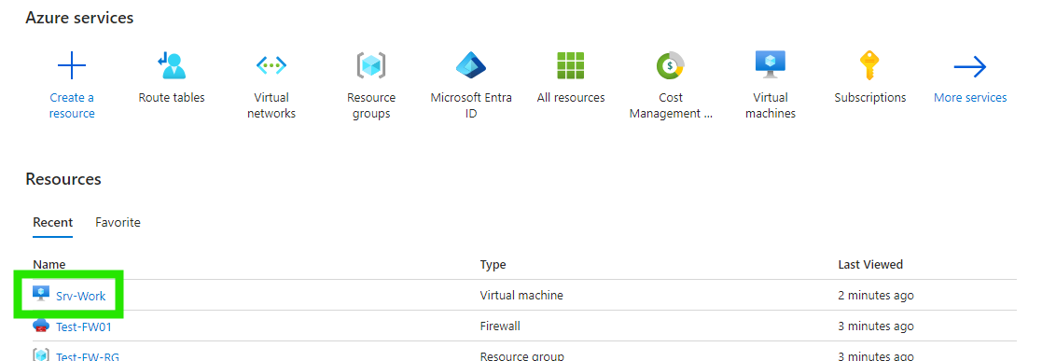
Change the primary and secondary DNS address for the Srv-Work network interface.
For testing purposes, configure the server's primary and secondary DNS addresses. This isn't a general Azure Firewall requirement.
Open the Srv-Work virtual machine.

Slide 47
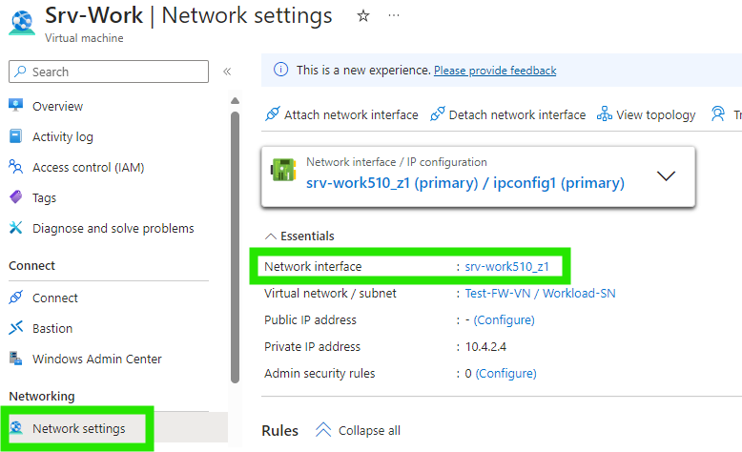
Under Networking, select Networking settings.
Select the network interface for the Srv-Work510_z1 virtual machine.

Slide 48
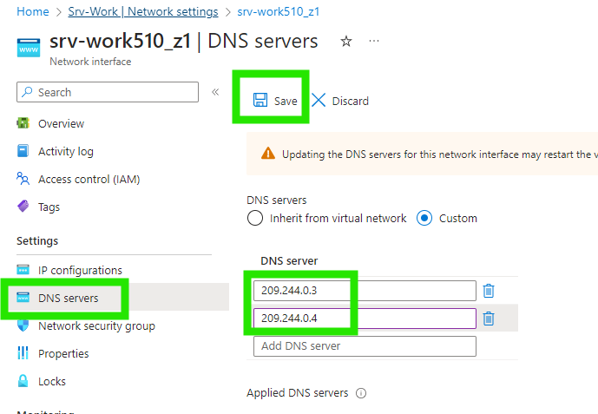
Under Settings, select DNS servers.
Under DNS servers, select Custom.
Type 209.244.0.3 and press Enter in the Add DNS server text box, and 209.244.0.4 in the next text box.
Select Save.

Slide 49
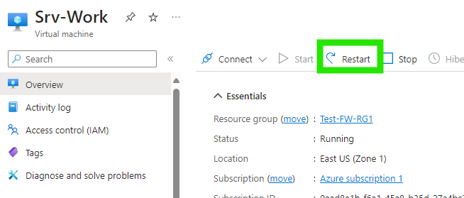
Restart the Srv-Work virtual machine.

Slide 50
Task 7: Test the firewall

Slide 51
Connect via your preferred connection:
Connect
Native RDP
Bastion
Windows Admin Center
Verify you can connect to www.google.com and not any other site.
Go to resources and delete all your built resources so you do not incur any further charges.

Slide 52

THANK YOU
Jack Priest

